Slide 1
Binary and Binary Logic
0100001001101001011011100110000101110010011110010010000001000011011011110110010001100101
OBJECTIVES
1. Be able to state what a BIT is
2. Be able to draw AND, OR, NOT Logic Gates
3. Be able to complete truth tables for AND, OR, NOT Logic Gates
4. Be able to complete practice exam questions combining Logic Gates

Slide 2
A Computer is quite possibly one of, if not the most stupid thing on the planet!
– Gabe (founder of Steam)
In fact, computers only know 2 things…
0 and 1
Off and On
T and F
Yes and No
Everything else is told to the computer by a human, this is called programming.

Slide 3
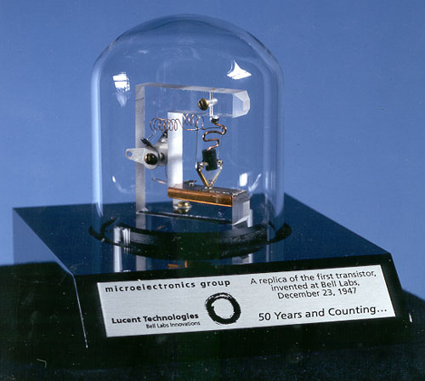
Computers have billions of tiny circuits inside. These are called transistors

Slide 4
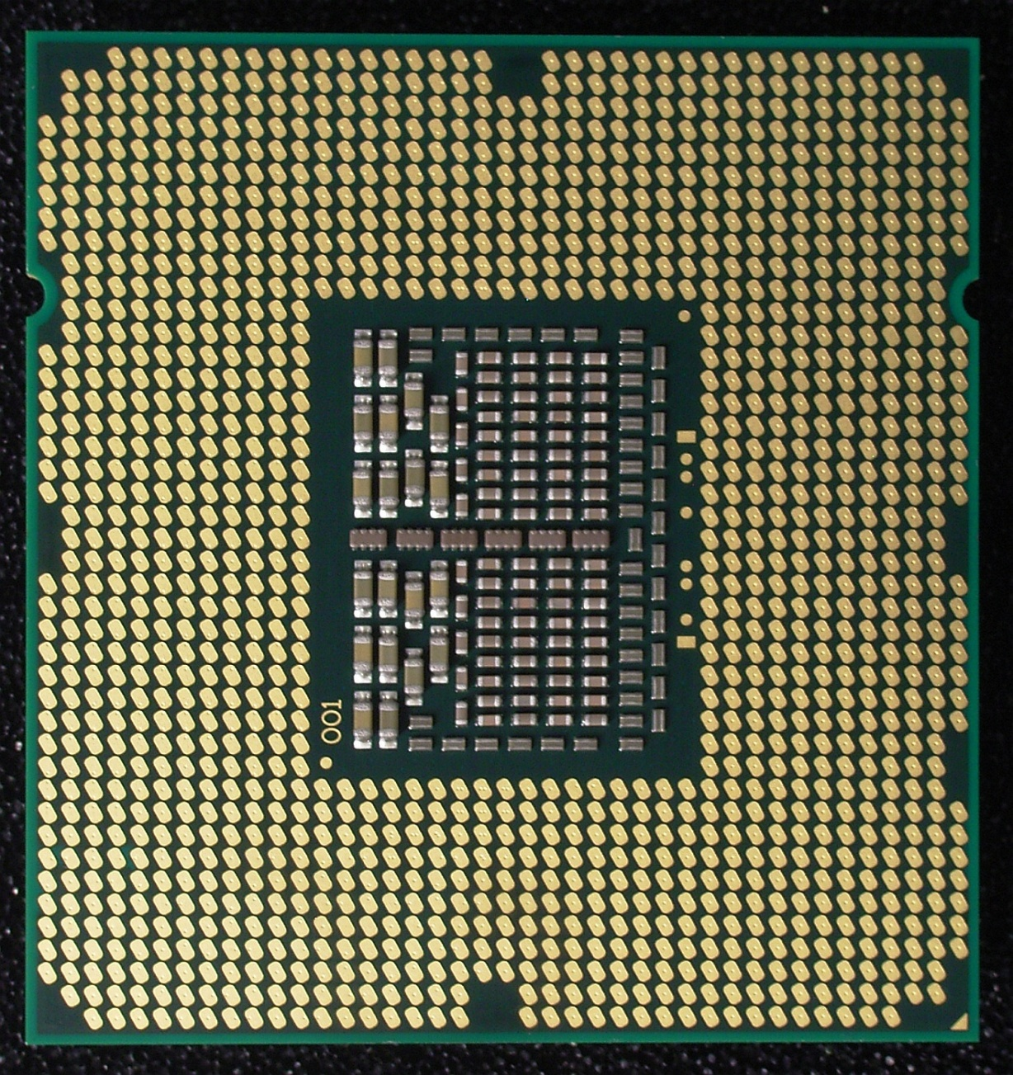

Slide 5
For a Computer
0 means turn a circuit off 1 means turn a circuit on
Each of these 0 and 1’s is known as a BIT
– A Binary Digit
Computers work by switching LOTS of these on and off very quickly in set combinations. And using Logic Gates to manipulate them

Slide 6
Logic gates
Digital systems are made up of logic gates.
These gates are the AND, OR, NOT, NAND,
NOR, EXOR and EXNOR gates.

Slide 7
NOT Gate
What does ‘NOT’ mean?
NOT could be read as the ‘REVERSE’. So if input is TRUE, then output will be FALSE and vice versa.

Slide 8
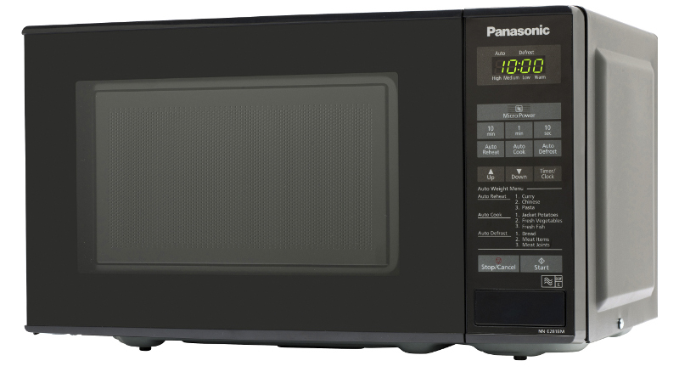
Real World Example
The Microwave will stop if the door is opened.

Slide 9
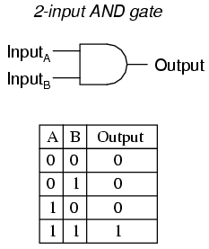
AND Gate
What does ‘AND’ mean?
AND could be read as ‘ALL’. This means that all inputs into the AND gate must be TRUE for the output to be TRUE.

Slide 10
Real World Example
The Microwave will only start if the start button is pressed AND the door close switch is closed.

Slide 11
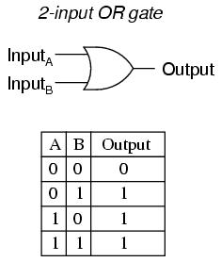
OR Gate
What does ‘OR’ mean?
OR could be read as ‘ONE OR THE OTHER’. This means that ONE of the inputs into the OR gate must be TRUE for the output to be TRUE.

Slide 12
Real World Example
House or School alarm system.
Sensors on the Door and the Windows
When the alarm is on: the Alarm will go off if the Door OR Window OR Both are opened.

Slide 13
Example Exam Questions
This one we can do together!

Slide 14
Example Exam Questions

Slide 15
Example Exam Questions

Slide 16
Objectives Review + Questions
1. Be able to state what a BIT is
2. Be able to draw AND, OR, NOT Logic Gates
3. Be able to complete truth tables for AND, OR, NOT Logic Gates
4. Be able to complete practice exam questions combining Logic Gates

